Slide 1
Analyzing your renovation project

Slide 2
Here’s what we’re going to cover
Things to know about the buy, fix and sell niche
Know all the costs of renovating and selling a property
Developing a detailed scope of work for your project
How to quickly analyze your deals
Lessons learned from flipping over 100+ properties

Slide 3
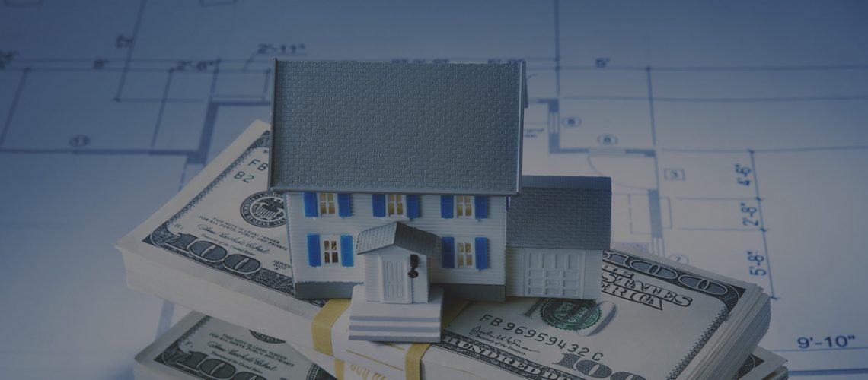
Things to know about the buy, fix and sell niche

Slide 4
Things to know about the buy, fix and sell niche
High risk, high reward — Hands down this is the most lucrative real estate niche out there. You can create big profits in a short amount of time. On the other hand if done wrong you can lose money quick.
Flipping is active income, not passive— Because flipping homes can demand a lot of time, many consider this niche not a “investing” strategy. It is an “active” real estate niche.
Contractors and trades— They play a huge role in this niche. Working with a trusted, reliable and dependable team will save you a lot of time and headaches. Working with contractors is a skill that is learned and perfected over time.
”Your make money on the buy”— The only aspect you have full control of when flipping a house is the price you buy the home at. You can’t control cost of renovations, sale price, the market shifts, timing of the listing, etc.
Working with the top realtors — For the most part, realtors will be selling your homes so you want to make sure you are working with the best in your area who sell a lot. Make sure they have a great marketing plan to execute.

Slide 5
Know all the costs of renovating and selling a property

Slide 6
Know all the costs of renovating and selling a property
Purchase price— The lower your purchase price, the higher your chance of profit. You are in control of this.
Deposit for property— You are credited this when you bring in money to purchase the property. Example $200,000 purchase price with $2,000 deposit given at time of offer written. Balance owing at closing is $198,000
Land transfer tax— This is a tax imposed by most Provinces in Canada to transfer the land from one owner to another. Visit https://www.ratehub.ca/land-transfer-tax for your Provinces land transfer tax
Property insurance— Having the right property insurance and fire insurance will protect your property in the event of a fire, property damage, vandalism, etc. This can be paid monthly or upfront. If the property is sold earlier you get a credit
Lawyer fee— A cost that you pay a lawyer who helps to transfer your name to the new home. Lawyers can also be hired to pull title on home, seeing if there are any liens, getting title insurance, etc.
Lender interest/profit share/fee’s— When flipping a property you will need to know how your going to fund the purchase.

Slide 7
Know all the costs of renovating and selling a property #2
Utilities— Water, hydro, electricity bills will have to be paid while you are renovating the home.
Furnace/hot water tank rental— If you bought the home and toke over this cost from the seller you will need to insure its being paid while you owe the home.
Mortgage break penalty— Whether it’s a mortgage at the bank or a private lender, sometimes breaking the mortgage term early (because you sold the home sooner then anticipated) might have a penalty owing.
Realtor commission— Commission paid to sell a home. On average between 4-5% plus GST. GST is 5% paid on total commission. Example $300,000 house sale. 4% commission is $12,000 and GST is $600. $12,000x .05 gives you $12,600
Staging of home— If you decide to stage your flip project (which we recommend) you will have to pay this cost. Most stagers will charge a monthly rental rate until home sells or when you decide to take the furniture out.

Slide 8
Know all the costs of renovating and selling a property #3
Clean up cost’s— Contractors debris can leave you place filled with drywall and saw dust. Paying for a cleaner is a smart choice and isn't a big expense. Its worth the investment when your home is being showed to potential buyers
Contractors/trades— Labor, material, permits and trades people (electricians, plumbers, etc) will need to be paid when doing work on your property.
Appraisal— If (not always) your bank or lender will require an appraisal on the home. This is a cost that might be incurred by you
Home inspection— If you decide to do a thorough inspection of a home, this will be a cost to you. However most skilled contractors can do this for free as part of their walk through inspection.
Title insurance— Not required but recommended. Protects against losses related to the properties title or previous ownership

Slide 9
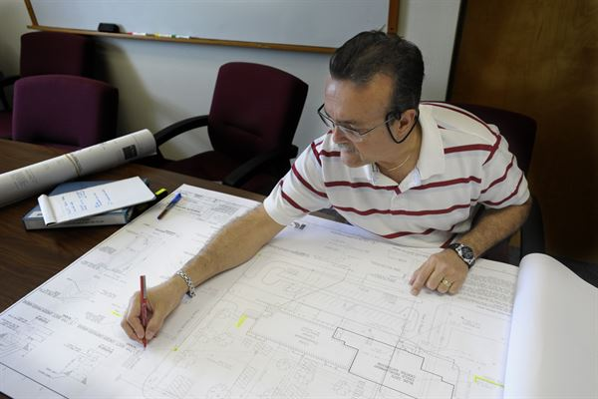
Developing a detailed scope of work for your project

Slide 10
Developing a detailed scope of work for your project
What is a scope of work (SOW) — Detailed list created by you for your contractor/trades person outlining all the work that you want to get done broken down into specific tasks with deadlines
Quote itemization form— This form tells you what the contractor will charge for specific tasks so you can compare price to other contractors quotes. You will need to have your SOW filled out for them to complete this document
Getting 3 quotes— We recommend always getting 3 contractors to quote/bid on the project. You don’t always want to go with the cheapest option however you want to see and compare the bids against each other
Giving a deadline— Because time is of the essence when your looking to purchase a property, you want to make sure you give your potential contractors a deadline to get there quote handed back to you.

Slide 11
How to quickly analyze your deals

Slide 12
How to quickly analyze your deals
Determine your comparable’s— Before deciding to go see a property have a rough idea based on information gathered on the call with your seller and your desktop analysis what your selling price might be approximately.
How is the deal funded— Depending if your buying the deal with your own funds, getting a traditional mortgage at the bank, doing a 50-50 JV or borrowing the money from a lender will help you determine what your approximate profit will be.
Your renovation budget— This is crucial in your analysis. The most important part, whether the deal is going to make sense or not to purchase.
Closing costs— Determine your down payment (if not all cash purchase), home inspection, appraisal, title insurance, land transfer tax and legal costs.
Holding costs— Determine your mortgage payment’s, property tax, property insurance and utilities
Selling costs— Determine your realtor commission, staging fee, mortgage break penalty, miscellaneous (spread sheet)

Slide 13
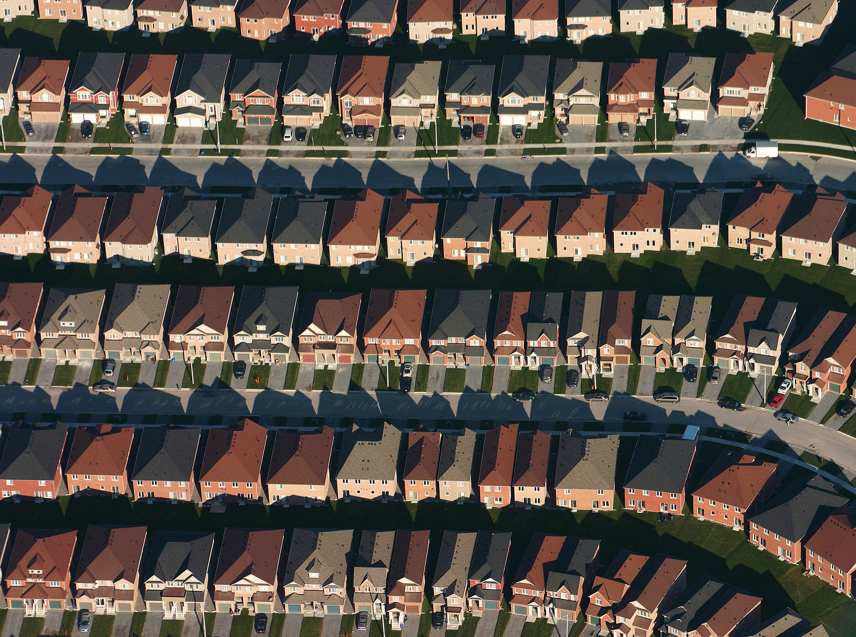
Lessons learned from flipping over 100+ properties

Slide 14
Lessons learned from flipping over 100+ properties
It pays to be nice— A home owner might decide to deal with you over another investor just because you are nice and because the other investor(s) were “salsey” or aggressive. It happens
Increasing your “probability”—The more home owners you talk and market to consistently the higher chance you have of finding great deals.
Unethical contractors are everywhere— You have to do the proper due diligence before you hand over your or your lenders money. People lie, take off, make up numbers.
Everything is negotiable—When raising money, know that there is more money out in the market than there are deals. You are the expert. A lender might have the funds to purchase but without you the deals not going to take place
Paying for materials yourself— When your new or even seasoned its very easy to be taken advantage of. Giving a contractor full reign to pay for materials as well as their labour can get a little blurred. Honesty isn't “common sense”.

Slide 15
Lessons learned from flipping over 100+ properties #2
When in doubt stage the home—I cant tell you how many homes I see that aren't staged selling on the market. The benefits of staging a home out way the costs. Staged homes sell for more, buyers can visualize their furniture.
Contrary to popular belief— Great deals aren't just found privately. You can still find great deals on the MLS, through realtor connections and hunting for them buy calling realtors consistently. Use the “5 a day” rule
Greater fool theory— Know that there is always someone who is willing to pay more for your property then you did either as a wholesale deal or if you renovate and sell it.
Speed is the name of the game— How quickly you respond to a private lead or a lead that’s been one day on the market will determine if you get the property under contract or not. You might just get it because you acted the fastest
There is always a buyer— If you price the home agressivley, have done a great job with renovations, staging and professional photos have been taken, you will increase your chances of selling the home.

Slide 16
Lessons learned from flipping over 100+ properties #3
Numbers don’t lie—If after analysing your numbers you see that it might be tight to make as big of a profit as you were hoping but you still want to take a chance. STOP! If you feel the numbers are tight, they probably are. Move on!
30+ DOM— Time motivates all. Because a home didn't’t sell in the first few weeks or even a month after listing doesn't’ mean is a bad deal. Might be priced high. Keep a look out for these deals that have been sitting on the market. There could be GOLD sitting there. Get on a 30+ search of homes on the market.
Proceed with caution— When your borrowing money from a lender they can easily be the one making all the profit. If the home sits to long on the market your profit and even your lenders profit can be washed away very quickly. Be conservative
Paying a contractor there final payment— Contractors, like any professions need to get paid for there work. However if the work is almost completed and you decide to pay a contractor early they might not come back and finish as quick
Use a 15% buffer fund— When a contractor gives you there quote for renovations add 15% on top. If that figure makes your numbers tight, walk away. Surprises are sure to happen in most renovation projects.

Slide 17
Lessons learned from flipping over 100+ properties #4
Networking pays— The more realtors in your network who are aware of your business the greater odds that they will call you with a Hot lead. You don’t want to rely on just one realtor to “feed” you. Network consistently and build relationships
Solving peoples problems—You need to discover quickly in your conversation with sellers what there fears and needs are with the sale of the home. Solve their problems as best you can and your chances of offers being accepted increases.
Don’t “over renovate”— It’s easy to dump tons of money into a reno project. Analyze comparalbes carefully. If homes on average (with a certain level of finishing) sold you want to make sure your reno’s are similar and don’t over do it
Have a plan “B”— If you find a good property but feel your over leveraged with other projects or money is tied up always have the plan B, like wholesaling it out to another investor for a quick profit. People will pay you for bringing them a deal.
Be diligent— If you are desperate for a deal, aren't careful with your number crunching, analyzing comparables you can get burned. Flipping homes requires careful analysis.

Slide 18
Lessons learned from flipping over 100+ properties #5
Having reserve funds— There is almost always some issue that is discovered when a buyer moves into your flip that wasn’t seen or used because the home was vacant. Be aware of this so you can take care of these issues right away.
Building your power team— Real estate investing is a team business. The success of your business is going to depend how strong and who you have on your team. Start building relationships with people who you want on your team. This includes contractors, insurance companies, lawyers, stagers, appraisal companies, lenders, etc.

Slide 19
Here’s your action items
Download Flip analyzer— Save to your desktop and use often to analyze your renovation leads.
Set up on a 30+ DOM search — Ask your realtor to set you up on a new email auto search. Whenever a property hits 30+ days on market you will get an email being notified.
Download SOW and Quote itemization forms — Use these two documents when you are working with contractors and doing a renovation on a project

Slide 20
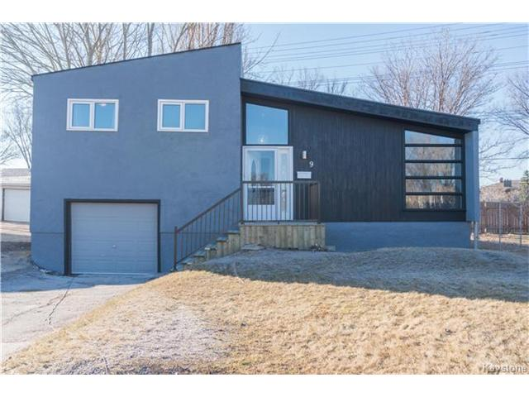
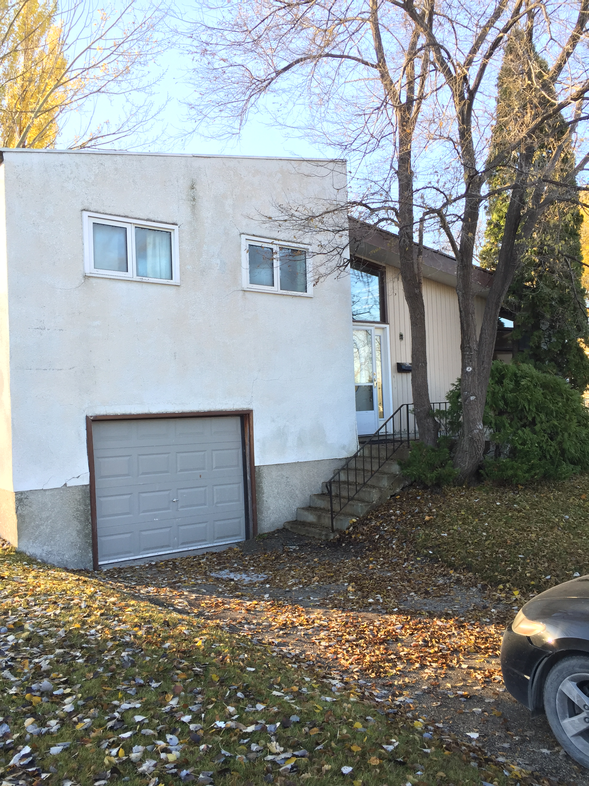
Be proud of what you do. Renovating homes adds huge value to cities, neighborhoods
& everyone involved

