Slide 1
Building each piece in order

Slide 2
Here’s what we’re going to cover
Joining the FB group
Q&A Calls
Values and Beliefs
The things that matter most: Marketing, Analyzing and Funding your deals

Slide 3
Joining the FB group

Slide 4
Joining the FB group
No complaining or negativity of any kind
The culture— Share your experience, knowledge and celebrate wins
Building valuable relationships by participating in posts and commenting if you have something to share
Asking questions, don’t tell stories.

Slide 5
Weekly Q&A Calls

Slide 6
Weekly Q&A Calls
Saturday’s 10:00-11:00 AM and Tuesday’s 6:00-7:00 PM CDT
Asking for help on the calls
Learning from others mistakes and wins
Leveraging the calls by implementing the suggestions, knowledge and real life experience
Your in the business for yourself, but not by yourself

Slide 7
Values and Belief’s

Slide 8
Values and Belief’s
Vision — Where you see yourself in the future will determine your daily habits. They need to be in line with your goals.
Having long term perspective— You need to think of your business with long term perspective. Failure is only temporary.
Working smarter, not harder— Using predictable systems, tools and strategies to grow your business.
Focus— Putting all distractions away and learning to say “NO”!
Persistence— The biggest benefactor to your success will be to keep going when times are good and times are bad.

Slide 9
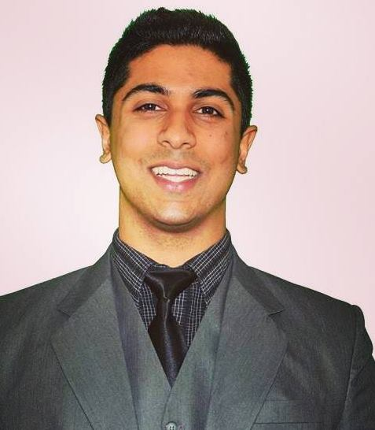
The only three things that matter
1
2
3
4
Marketing
Analyzing
Funding
Leverage point 4
PUT YOUR IMAGE HERE
“You will be tempted to do anything other than the work to find deals and close a lenders. Keep it simple and execute on these three things daily".
-Manjit Rukhra

Slide 10
Here’s your action items
Joining the Facebook Group— https://www.facebook.com/groups/raiseprivatefunds/
Join weekly Q&A calls found in FB group events tap
Print out pinup “The 3 things that matter most”

Slide 11
Focus on your vision daily!

