Slide 1
Money school

Slide 2
Here’s what we’re going to cover
What is money?
Interest income and Capital Gains. How investment returns work
Profits from flipping
Rental income, appreciation, mortgage payment and refinancing
Understanding investment vehicles in your marketplace
Most common real estate terms and definitions

Slide 3
What is money

Slide 4
What is money
What are your thoughts and beliefs on money? — Many people grew up believing or being taught that money is the root of all evil. This is taken out of context and is actually similar sounding from a bible verse that reads “For the LOVE of money is the root of all evil” 1 Timothy 6:10
Money is a tool— At the core level money is just a tool that people use to buy, sell, trade and invest with. It can provide oneself the “good life”. You can also put it on a pedestal and become greedy with it. Money is not evil per se however if used improperly it can cause pain and grief if you start “loving it”.
Money amplifies who you already are — If you’re generally a good person and you get more money you will most likely do good with it. If your not a good person it will enhance your character, actions or personality for the worse.

Slide 5
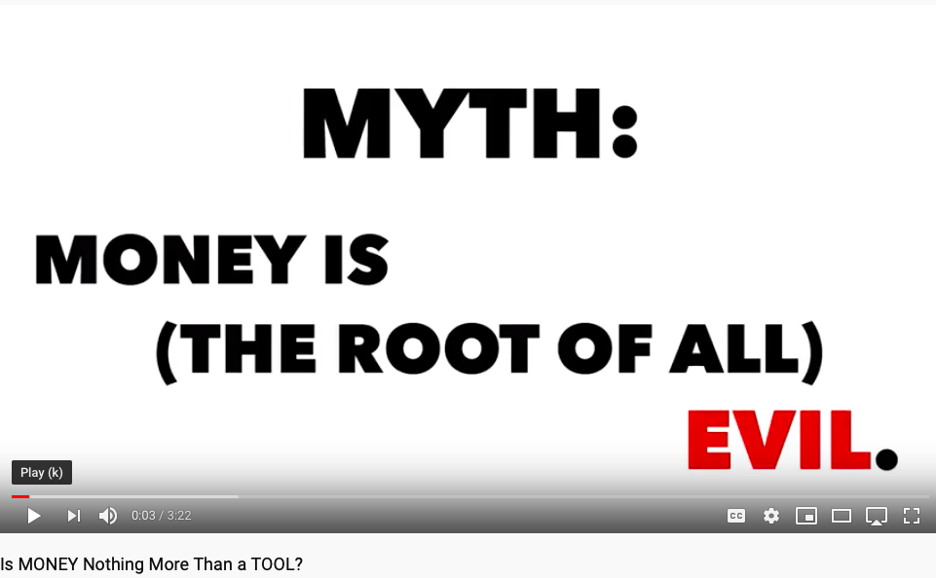
Link: https://www.youtube.com/watch?v=jHBhCfHT2Es

Slide 6
What you are good things you are going to do with more money?
You raise capital when you add value— Money only exchanges hands when you provide value to someone. Whether that is providing a better return on their money, giving them more security then the market place can or having it grow faster.
When you raise money you are creating many jobs — Because of your ability to raise capital which will lead you to purchase real estate, many jobs will be created thus many families being able to make an income for themselves. Realtors, contractors, insurance brokers, appraisers, home inspectors, stagers, lawyers, mortgage brokers and the list goes on.
You are able to design the life you want and live it— Again, money is a tool and if used for good you can do many good things for your family and others around you. Real estate Investing is one of the highest paid professions on this planet.

Slide 7
Interest Income and Capital Gains

Slide 8
Interest Income and Capital Gains
What is the difference— Knowing the difference between these types of investment returns and they relate to your prospects current portfolio is going to be crucial. Different investment vehicles make different returns. Example RRSP’s, TFSA’s Mutual Funds, Stocks and so on.
Educate the marketplace —Someone once said “The one who educates the market, owns the market”.
Interest income and Capital gains— Your lender will either make interest income on the money they borrow you or capital gains. This depends on if they are investing with you in a lender/borrower relationship or are they a partner with you on a project and your splitting the profits. Example 50/50 share.
Know your niche and how your lender makes a return— Whether your flipping homes, holding rental properties that cash flow or your niche is wholesaling knowing your area of focus will help you raise more money because you will be an expert in that field. Especially when it comes to paying taxes on the returns.

Slide 9
Interest Income
Interest income is created when an investor loans someone or a company their money. Interest payments are commonly found in Guaranteed investment certificates (GIC’s), government bonds, government registered funds like RRSP, RESP’s, RRIF or bank savings accounts. Interest income is taxed 100%
If someone is paid $5,000 in interest in 2019, that $5000 is taxable income and gets added to the other income (like a job salary) they made that year.
Interest income and real estate: The beauty about when a lender earns interest from the money they borrow you is that interest rate is usually much higher then what someone can earn in the market place in the investments mentioned above.
Interest income on private loans borrowed to you usually range anywhere between 8%-12%. This makes prospecting for money easier when your real estate project will pay your prospect lender a better, generally safer, secured return, which is the real estate property itself.

Slide 10
Capital Gains
Capital gains are created when a someone profits from the sale of a security such as a stock or share inside a mutual fund or a property. The investor is taxed on that gain in the year that investment is sold.
If an investor purchased a stock or property in 2019 for $100,000 and sold it for $150,000 a year or two after then 50% of that gain would be taxed. So that total $50,000 gain, only $25,000 would be taxed.
If that investor earned a salary of $100,000, that investor would be taxed as though they made $125,000 (half of the $50,000 gain).
When your buying and selling real estate like flipping properties you pay capital gains.
If your lender is not loaning you money but is partnering up with you, you would both make a capital gain when you sell the property.
This capital gain is exempt when you buy and sell your principal residence (the home you live in)

Slide 11
Profits from flipping properties

Slide 12
Profits from flipping properties
Taxation of flipping homes— If you are flipping homes in your personal name you will pay capital gains tax. As stated previously, 50% of the total gain or net profit is taxed and added to your total income from other sources like other investments or job (if you have one) in the year you sell the home.
Things to consider— If you start to flip a lot of homes your profit can be eaten away from taxes. To avoid this you can create a corporation and have the corporation do the buying and selling. You pay a much lower tax rate on your profits in a corporation. A accountant who is familiar with real estate investing will be able to help with this.
You and your lender aren't taxed the same — Depending if your lender is a partner or borrowed you the funds that will determine how they are taxed. Finding out this information will help you educate prospects and help in negotiations of rate and terms.
One of the fastest ways to increase your income —Buying discounted properties. Be sure you are working with a good accountant who can help you keep most of those profits in your jeans.

Slide 13
Rental income, appreciation, mortgage pay down and refinancing

Slide 14
Rental income, appreciation, mortgage pay down and refinancing
Multiple ways of earning income from rental properties— Having a good understanding of the different ways to create an income for you and your lender is powerful. Being able to explain this clearly will be critical to your success.
Rental income— You can reduce your taxable income (income made from rent paid) by deducting specific expenses, like those you incur to get the property ready for rent or while renting out the property. For example money spent on maintenance and repairs. (note: income is taxed differently in partnerships and corporations)
Property appreciation— A rental property will naturally appreciate in value over time. This appreciation is not taxed until you sell the property down the road. At which time depending if you own it personally or in a corporation you will pay capital gains tax. Considered tax deferred.
Continued…

Slide 15
Rental income, appreciation, mortgage pay down and refinancing
Mortgage pay down— You only pay tax on the principal portion of your mortgage payment. Not the interest portion. Example: $1000 mortgage payment. $300 is principal and $700 is interest, you pay taxes on that $300. Even though you don’t see this principal payment as savings or profit in your bank account you’ve made that money in equity. (Forced savings)
Refinancing your rental — When you go to refinance your rental and take out the cash from renovating or owing it over the years that money you take out is not taxed. Since this does not qualify as income to you, no tax is due on the initial cash take out if done personally. Refinances, might have other tax implications (always check with your accountant)

Slide 16
Understanding investment vehicles in your marketplace

Slide 17
Understanding investment vehicles in your marketplace
Equity in property—One of the largest untapped sources of capital. Makes no return on equity build up. Can borrow at low interest rates.
Savings accounts— Pay the lowest returns in the market on money. Low risk, low return. Lots of money sitting with banks and credit unions.
GIC’s— Guaranteed investment certificate. Money is either locked in for a certain amount of time, usually 30 months to 10 years. Some GIC’s are redeemable, some aren't. Returns are guaranteed however they pay very low returns. On average 1-3%.
Government Registered Savings Plan— Most common type of registered savings plan is a RRSP. Account holders usually have stocks or mutual funds invested inside these retirement accounts paying subpar returns.

Slide 18
Home Equity

Slide 19
Equity in property
Idle equity in your home— Most people don’t realize this but having there home paid off or almost paid off is not getting them ahead. Lender can borrow you their equity in exchange to a sharing profits or making interest income in your project. Your lender can also write off interest on the money borrowed to invest.
What is the return on equity— The rate of return you make on having your home paid off is $0. Meaning because its considered idle, not invested anywhere you aren't making it work for you. Once you borrow that money and invest it In real estate your equity has a chance to grow and work.
Borrowing at low rates— You can borrow at low rates with the bank. Most banks will loan you 80% LTV (loan to value) on your home. So if your home is worth $300,000 and paid off you can access $240,000 of that equity in a form of a line of credit.

Slide 21
Savings Account
Average bank savings rate— The average bank savings rate is 1%. This is if you have a minimum balance sitting there. People with these types of funds are good savers. Having money for a “rainy day” that usually never happens.
Money is very liquid— If you come across a potential lender like this who has capital available you know they can access the money very quick if need be.
Where to find this— Generally speaking people who have these sorts of funds are usually a bit older, senior citizens, people who are retired, your grandmother.
Very conservative in nature— Be sure they understand the in’s and out’s before they commit to lending you money. Take extra time if need be to make sure they are comfortable with you and investing in real estate in general.

Slide 22
Guaranteed Investment Certificates

Slide 23
Guaranteed Investment Certificates
Biggest bank selling product— This is because your everyday banking client puts their money in a GIC either because that is all they know about, are comfortable with or what the banker has suggested they do.
Locked in and redeemable funds— If a potential lenders money is in a locked in term. Usually 1-5 years its nearly impossible to access it unless it’s a dire emergency. These products pay interest income meaning what you make on a return is fully taxable. 100% taxable
They pay very low rates of return— Returns are guaranteed however they pay very low returns. On average 1-3%. This makes moving money from lenders GIC’s to your project easier as on average a lender usually makes is 8-12% return per annum in real estate.
Read this blog post— https://raiseprivatefunds.com/blog-post-one

Slide 24
Government Registered Savings Plans

Slide 25
Government Registered Savings Plans
Registered Retirement Savings Plans — Most common type of registered savings plan is a RRSP.
Government financial account — You can hold investments such as a GIC’s, Bonds, Mortgage loans, Mutual funds and other investment products.
Contributions— . Contributions are tax deductible and can lower your taxable income for the year. Income made in account is tax deferred. Grow tax free however your fully taxed on with drawl.
Largest untapped market for capital— Registered savings plan holders can loan you money in a form of a mortgage.
Lender has more security on their money— There money is secured by the real estate deal. Lawyer draws up a mortgage like any bank would. When they transfer over funds from current institution to you its not taxed as it’s a “transfer in kind”.
Higher and consistent returns— Lenders usually can earn 8-12% return from you. Everything is negotiable.

Slide 26
Most common real estate terms and definitions

Slide 27
Most common real estate terms and definitions
After repair value (ARV)— What a property will be worth on the market, usually after renovations and updates.
Comparables (Comps)— A list of homes that have recently sold which you can use to compare your property to once renovations have been completed. Comparing “apples to apples”. A realtor on your team can give you comparables in your requested area.
Skin in the game— An amount of money that you put down or into the deal yourself. Lenders sometimes want to see this
Loan to value (LTV)— Banks and other lenders use LTV ratio to assess risk. The higher the LTV the more risk to a lender
Due Diligence— Doing further investigation into the property. Are there liens on title, foundation work required, ect
Cap rate— A calculation used to compare one property to another. Calculated by dividing your annual net operating income by purchase price. Example $30,000 Annual NET income/ $300,000 purchase price = 10% Cap rate.

Slide 28
Most common real estate terms and definitions continued…
Return on Investment (ROI)— Used to compare one investment to another. Measures the amount of return of an investment, relative to the other investment costs. Example: Amount returned or made $20,000 / Cost of investment $200,000 = 10% ROI or return on investment.
Equity— Refers to the amount the home is worth today in comparison to what is owed on the mortgage. The difference in that amount equals equity. Example: Home value $300,000. Mortgage $250,000. Equity is $50,000
Cash flow— The amount of money left over every month from the rent minus all expenses including mortgage payment, taxes, utilities (if you pay), property insurance, maintenances, repairs and vacancy.
Pre approval letter— A signed letter obtained from a bank confirming a approval in a dollar amount of that they would lend you to buy a home. These approvals are usually good for 90 days.
Continued…

Slide 29
Most common real estate terms and definitions continued…
Appreciation— This represents an increase in value of a property over time. Generally speaking homes will increase in value at a rate of 1-2% every year conservatively.
Net operating income (NOI)— This refers to income from a property generated annually after deductions like property tax, property management, maintenance, repairs. This calculation does not include mortgage payment. For example annual income is $60,000, total expenses are $20,000. Your NOI is $40,000

Slide 30
Here’s your action items
Print out “Most common terms in real estate” and start reading it daily until you get familiar with it

Slide 31
Pick one to two strategies and execute

